Slide 1
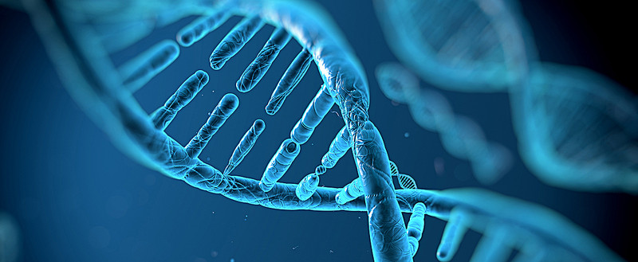
Hippopotamus, Minke Whale, & Wild Boar DNA Comparisons
Group 1
Notes:
Ashlee

Slide 2

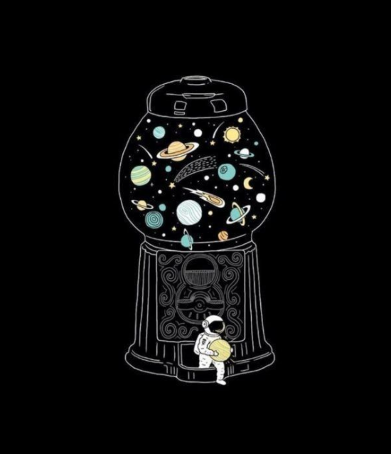
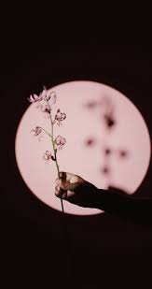
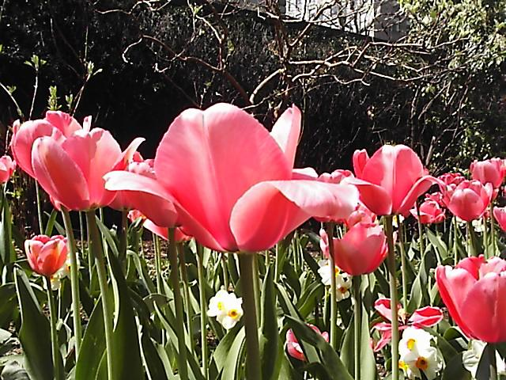
Introduction to the Team
Ashlee T.
Claire N.
Isabella S.
Rashini P.
presentation formatting, coding the visualizations, coding slides
presentation formatting, animal researching, animal slides
coding screen sharing, coding main project,
coding challenge 2
presentation screen sharing, animal researching, animal slides
Notes:
Everyone does in order

Slide 3
Project Goals
Why Code?
Figure out which two animals of the three that we were given are most closely related through code
Collaborate with each other in an effective manner
Develop our coding skills through this project
Attempt at least one of the coding challenges provided
Easier and more effective to present large amounts of information
Is a useful skill to have in the future because of technology's impact
Notes:
Claire
Completed
Our project goals were to…
Why code?
Code is...

Slide 4
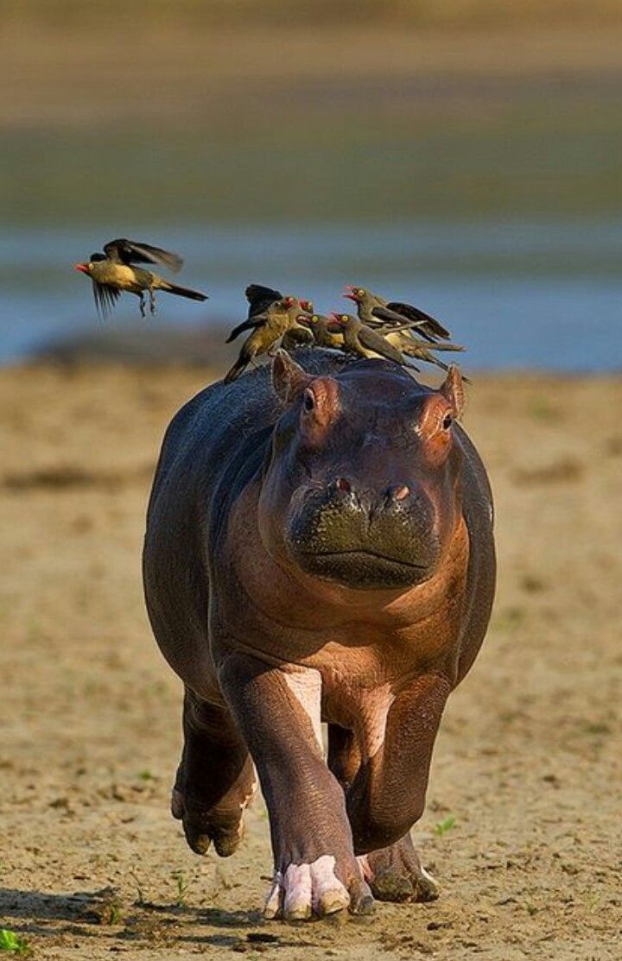
Introduction to the Animals: Hippopotamus
Semi-aquatic mammals
Found in areas with abundant water
Live in Sub-Saharan Africa areas
Mostly feed on grass and occasionally fruits
Herds of 10-20
Live for around 40 years
Population of 125 - 148 thousand
Notes:
Claire - completed but can add
Hippopotamuses are semi-aquatic mammals that are found in Sub Saharan Africa areas but more specifically areas that are abundant with water and spend most of their time in the water to keep cool. They mainly feed on grass and occasionally fruits if they are available. Hippopotamuses live in herds of 10 - 20 and live for around 40 years though while in captivity, some have lived for up to 50 years. Hippopotamuses have a population of around 125-148 thousand and many are living in protection due to the decline in its population.

Slide 5
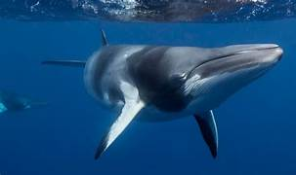
Introduction to the Animals: Minke Whale
Typically found in the Northern Hemisphere, and throughout the northern atlantic and pacific oceans
Eat crustaceans, plankton, and small schooling fish, sand eels, etc.
Two main species of Minke Whales: common minke whale and the antarctic minke whale
Population: around 500,000.
Migrate seasonally, to the poles (during the spring) and towards the tropics (for fall and winter)
Consumed by Killer Whales
Notes:
Rashini- Completed but can add
Crustaceans- animals such as crabs, lobsters, crayfish, shrimps, prawns, krill, woodlice, and barnacles.
There are two main types of minke whales, (the common minke whale and the antarctic minke whale) these whales can be found along the coast of the Nothern Hemisphere and the atlantic/pacific oceans. And their diet consists of
crustaceans
crustaceans

Slide 6
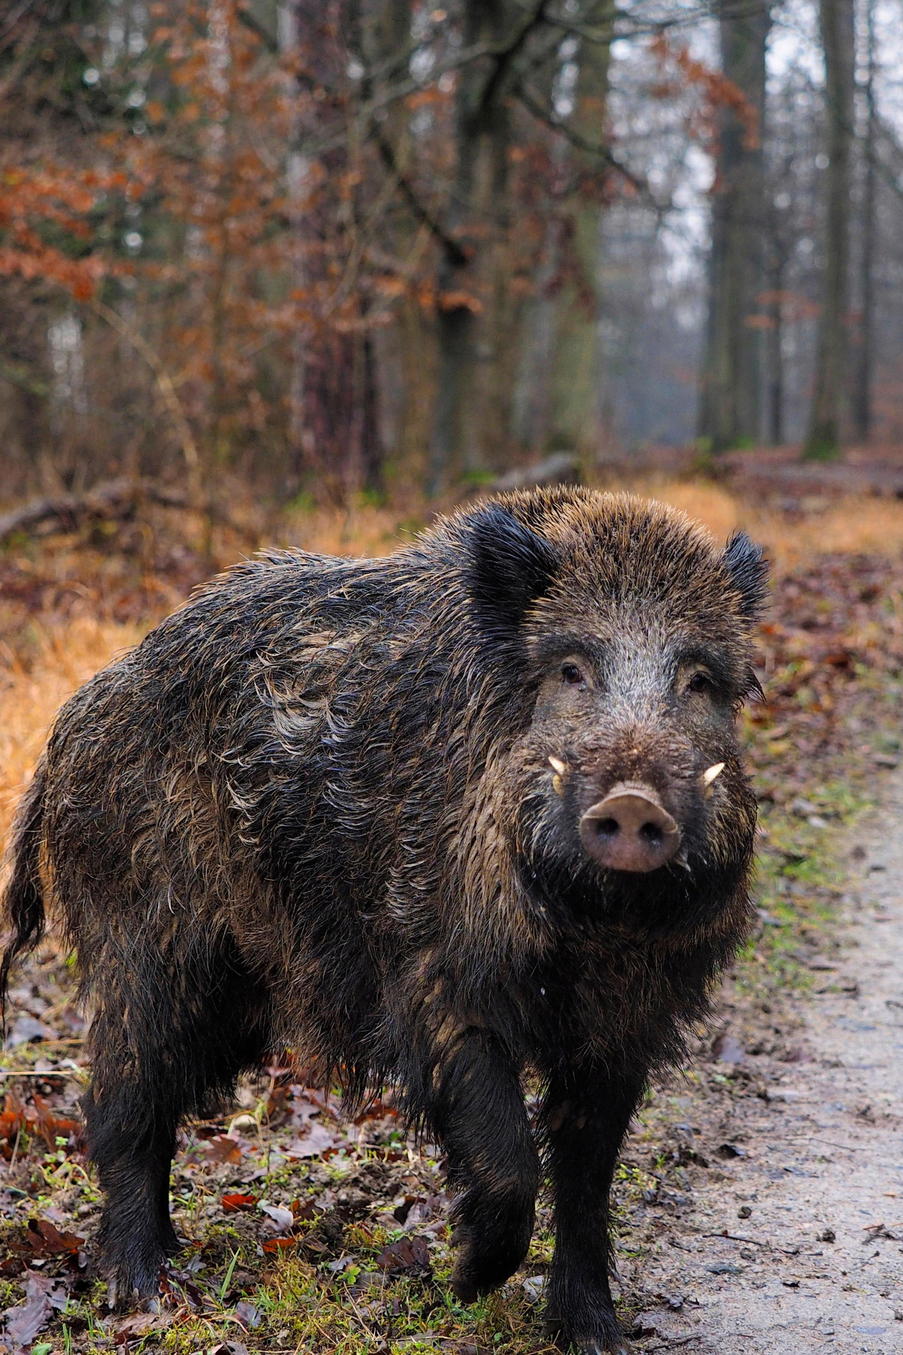
Introduction to the Animals: Wild Boar
A suid native to Eurasia and North Africa
One of the widest-ranging mammals in the world
The ancestor of most domestic pig breeds
As of 2005, 16 subspecies of wild boar have been recognized.
Population of about 6 million
Omnivorous
Notes:
Rashini -
Claire:can i add abt their diet also ill add speaker notes
Wild boars are a suid native to Eurasia and North Africa. They are one of the widest ranging mammals in the world and are the ancestors of the most domestic pig breeds. As of 2005, 16 subspecies have been recognized with a population about 6 million. Wild boars are omnivorous so most of their diet consists of plants.

Slide 7
Hypothesis
Introduction to the Gene
Our hypothesis was that the Hippopotamus and the Minke Whale are the two most closely related species. Our reasons for this hypothesis were:
Both the Hippo and the Whale are amphibious animals
Neither the Hippo or Whale have fur all over as the Wild Boar does
The Hippo and Whale are more similar in size than the Wild Boar is to either of them
The genes that we were comparing were DNA sequences of the hippopotamus, the minke whale, and the wild boar. The reason why we chose to compare DNA rather than RNA or proteins is to ensure maximum differences are shown.
Notes:
isabella -completed
Before we began coding, we created our hypothesis, which was that “ “ Our reasons for this hypothesis was “ “”
We also determined what

Slide 8
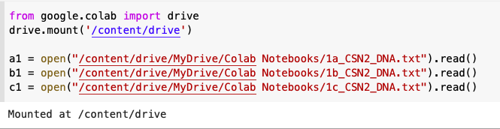
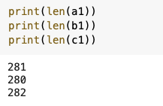
Before Starting the Comparisons
We mounted our drive and assigned out txt files to variables. We also printed out the length of the variables to help us with percent similarity later on.
Notes:
ashlee- completed

Slide 9
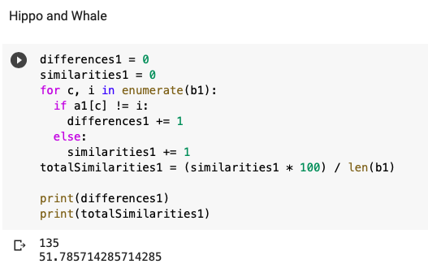
Hippo & Whale Code
Python features used: for-loop, if statement, enumerate
Variables used: differences1, similarities1, a1, b1, totalSimilarities1
135 differences between the DNA
~52% similar
Notes:
isabella- completed
For the hippo and whale code, we used a for loop, a conditional, and enumerate. The variables we created and used are

Slide 10
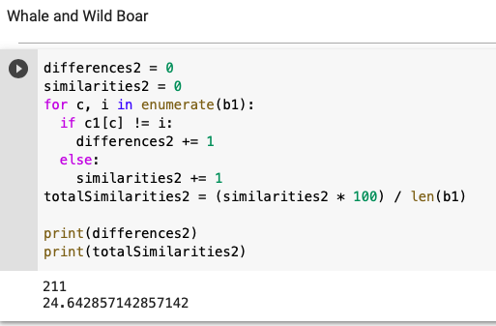
Whale & Boar Code
Python features used: for-loop, if statement, enumerate
Variables used: differences2, similarities2, c1, b1, totalSimilarities2
211 differences between the DNA
~25% similar
Notes:
Rashini

Slide 11
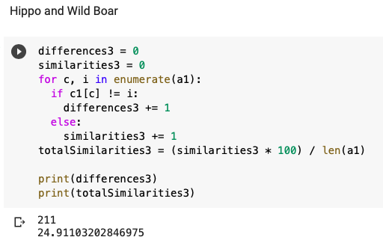
Hippo & Boar Code
Python features used: for-loop, if statement, enumerate
Variables used: differences3, similarities3, a1, c1, totalSimilarities3
211 differences between the DNA
~25% similar
Notes:
Claire
For the code, again, we used a for loop, if statement, and the function enumerate and used the variables…
We ended up finding 211 differences between the hippo and wild boars dna which meant they were around 25% similar.

Slide 12
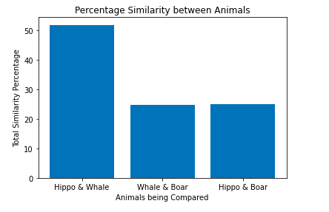
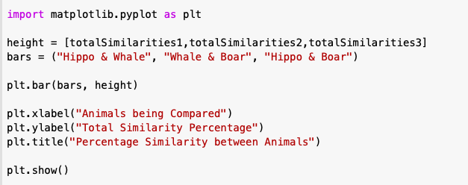
Bonus Challenge 1
We chose a bar graph because we thought it would best represent the comparisons between the similarity percentages.
Notes:
Ashlee- completed
why we chose a bar graph

Slide 13
Bonus Challenge 2: Hypothesis
We first came up with a hypothesis. We thought that the gorilla would be the most closely related to the human, followed by the chimp, then the orangutan, etc. and then we put it into a list.
Notes:
In progress
Claire

Slide 14
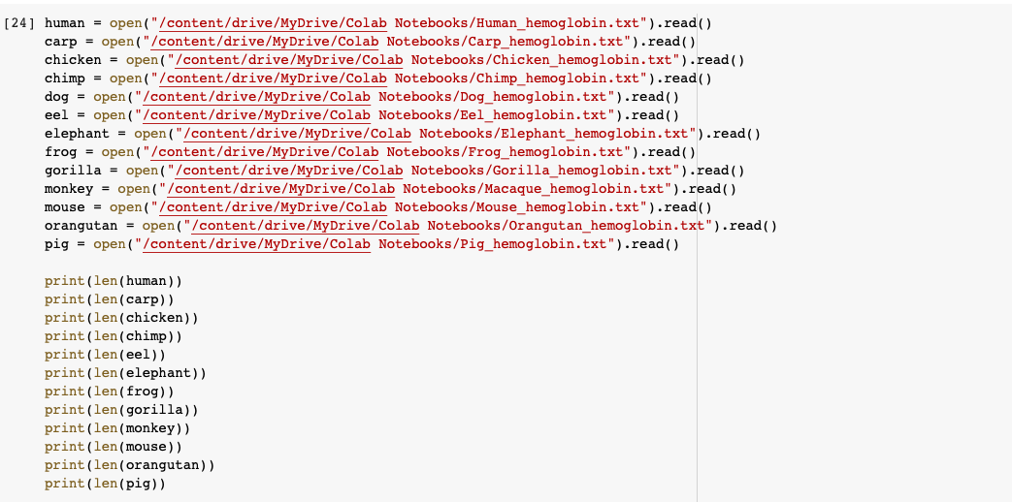
Bonus Challenge 2: Code
Notes:
Isabella
We used open and read to read in the text field with the animals hemoglobin. Then we printed the length of each file to find out which was the shortest

Slide 15
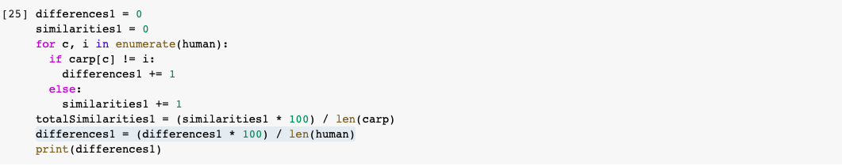
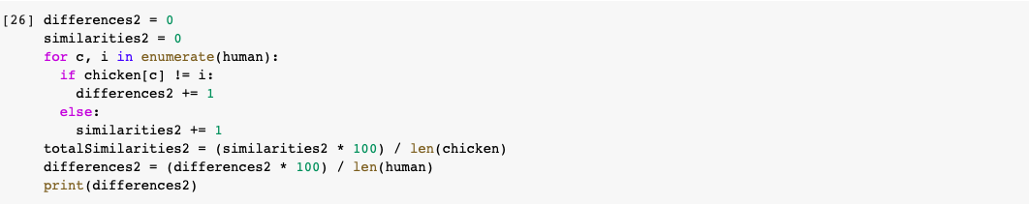
Bonus Challenge 2: Code
Notes:
Isabella
Here we did the same thing we did to find the similarity percentages between the other txt files except in this one we found the differences

Slide 16
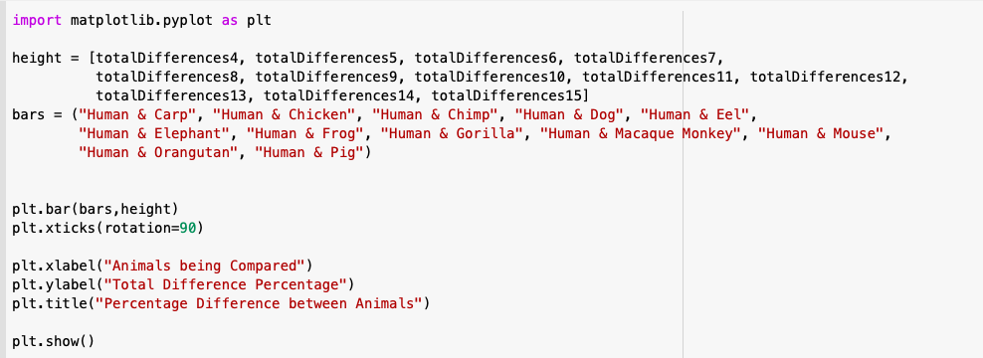
Bonus Challenge 2: Graph Code
Notes:
Ashlee

Slide 17
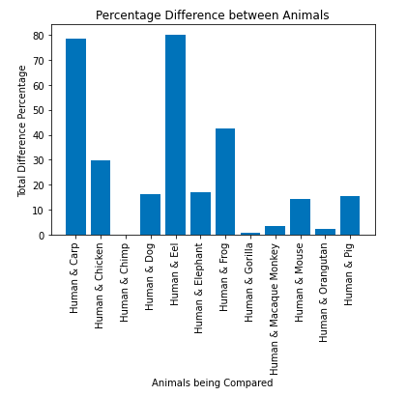
Bonus Challenge 2: Results
We discovered that humans are actually most closely related to the Chimp. The rest of the order was:
Chimp (0.0%)
Gorilla (0.71%)
Orangutan (2.12%)
Macaque monkey (3.54%)
Mouse (14.18%)
Pig (15.60%)
Dog (16.31%)
Elephant (17.02%)
Chicken (29.78%)
Frog (42.55%)
Carp (78.72%)
Eel (80.14%)
Notes:
Rashini
So, this was bonus challenge 2, and we discovered that the humans where most closely related to the chimp, because as you can see in the bar graph, they had the least differences compares to the other animals.
(here we have them ordered in numerical order from least to greatest, with the chimp being in the beginning)

Slide 18
Coding Problems Faced
Labelling the xticks in our bar graph
Because of the way our bars were plotted in the beginning, there were issues in labeling each specific graph
Solution: we used google and collaborated together to figure it out
Spacing out our ticks so we can read the words
Because of the length of the words of the second bar graph, we had problems reading the labels
Solution: collaborating on ways to solve the problem and googling how to figure out the solution
Notes:
Ashlee

Slide 19
Conclusions
Next Steps
Our hypothesis was correct
Hippo and Minke Whale are most similar
Wild Boar and the Minke Whale are the least similar
Add more animals to compare
What makes them similar?
Create more visualizations
Notes:
Claire - in progress
We have concluded that our hypothesis is correct. The hippopotamus and minke whale are the most similar to one another since we saw that on our graph their similarity percentage was over 50% while the minke whale and wild boar as well as the wild boar and hippopotamus both had similarity percentages that were below 30.
Our next steps for our project would be to compare more animals and figure out how in what ways they are similar specifically. As well as creating more graphs or visualizations to represent out data.

Slide 20
Citations
https://www.awf.org/wildlife-conservation/hippopotamus?gclid=CjwKCAjwmK6IBhBqEiwAocMc8jOcRU4SBFW-MXWhvnMgbeVqTsWa8Evfk8U3kLX3Oh_AsvrDiLs-NRoCv8IQAvD_BwE
https://en.wikipedia.org/wiki/Wild_boar
https://kids.kiddle.co/Mysticeti

